Slide 1
Greek Minuscule Script
Font and Keyboard presentation
Konstantina Eleftheriadi
M.NR.: 7418145
Übung Preserve our shared Cultural Heritage – Recorded Data, Writing Systems, Scripts
Lecturer: Vyshantha Simha
Summer Semester 2024

Slide 2
Structure
The Greek Minuscule
The font
The keyboard
Purpose
Refinement

Slide 3
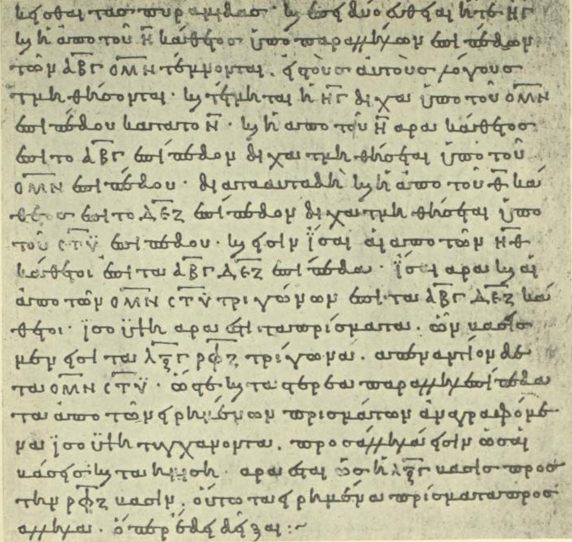
The Greek Minuscule
Development: 9th-10th c. in Constantinople
Commonly used in Byzantine Manuscripts after the 10th c.
Different styles, traditionally categorized in 4 larger periods (Thompson 1911)
Codices Vetustissimi (9th-mid. 10th. c.)
Codices Vetusti (mid. 10th-mid. 13th c.)
Codices Recentiores (mid. 13th-mid. 15th c.)
Codices Novelli (mid. 13th-…)
Bodleian Euclid, 888 C.E. (Thompson 1911, 223)

Slide 4
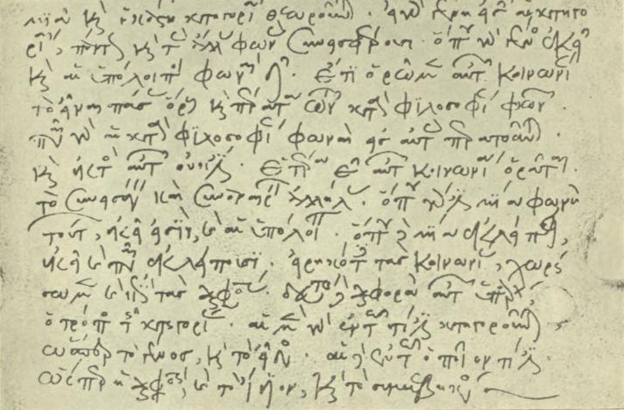
The Greek Minuscule (cont.)
Lower-case letters;
though oftentimes upper-case letters (unicial) intermixed
Duplicate(+) forms of letters
Ligatures
Abbreviations
“Formal” and “neat”, yet steadily developed more freely –and diversely
Commentary on Porphyry, 1223 C.E.. (Thompson 1911, 251)

Slide 5
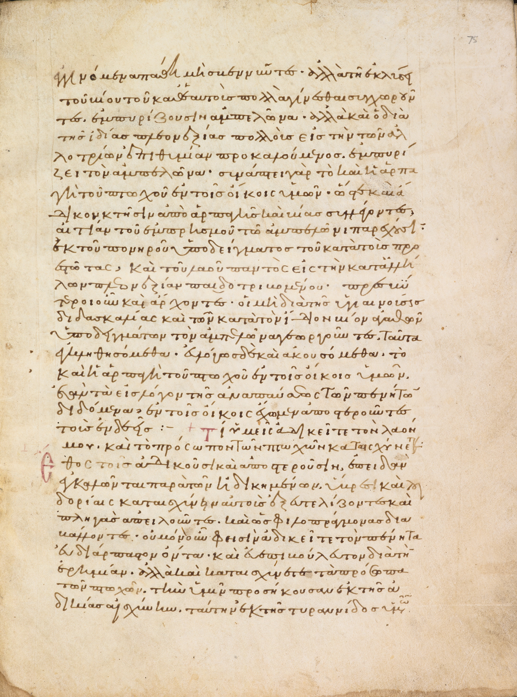
The Font
Based on the Bodleian – MS. Barocci 102 Manuscript (Commentary on Isaiah by Basil the Great)
Dated: 1090-1100
Typical example of 11th c. Minuscule script
Readable and in fairly good condition
Transcribed
Fully digitized and available online
Bodleian MS. Barocci 102 fol. 75r

Slide 6
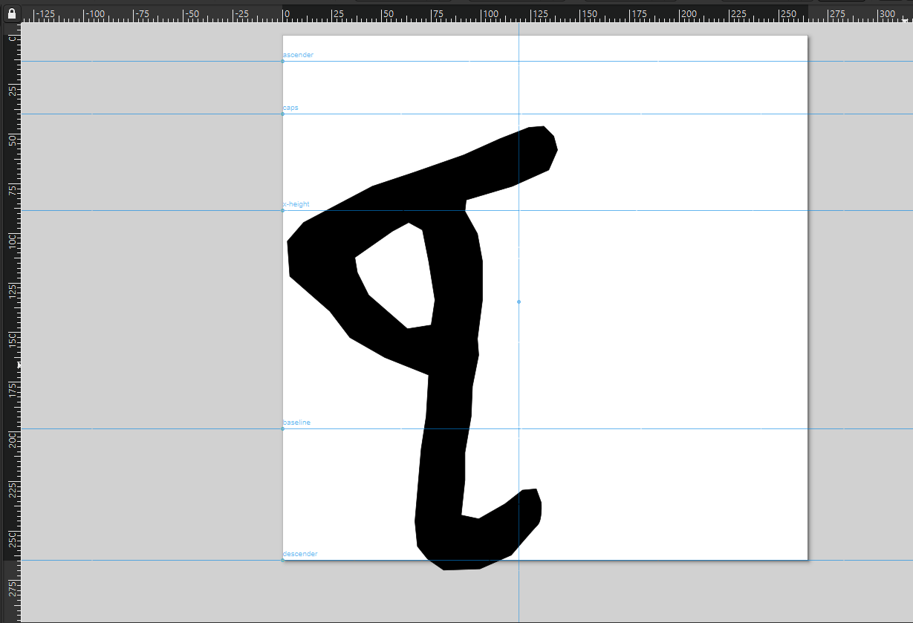
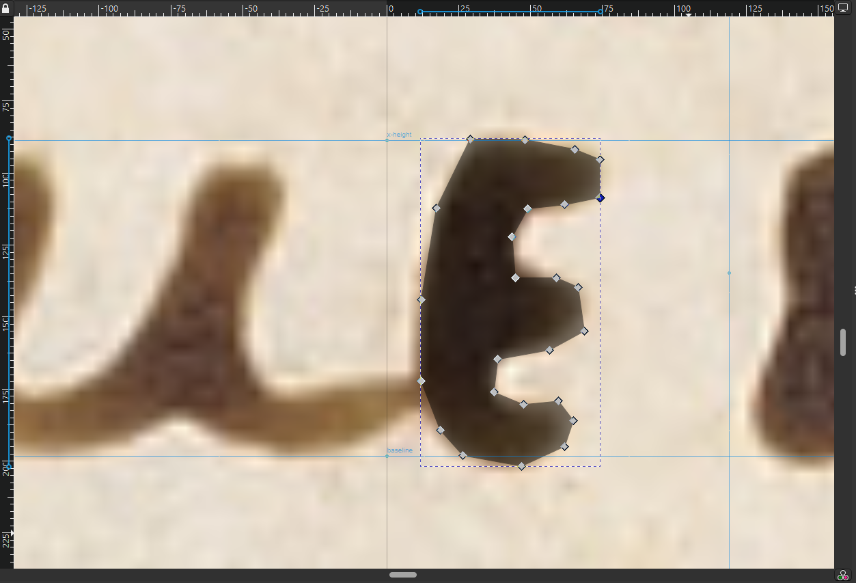
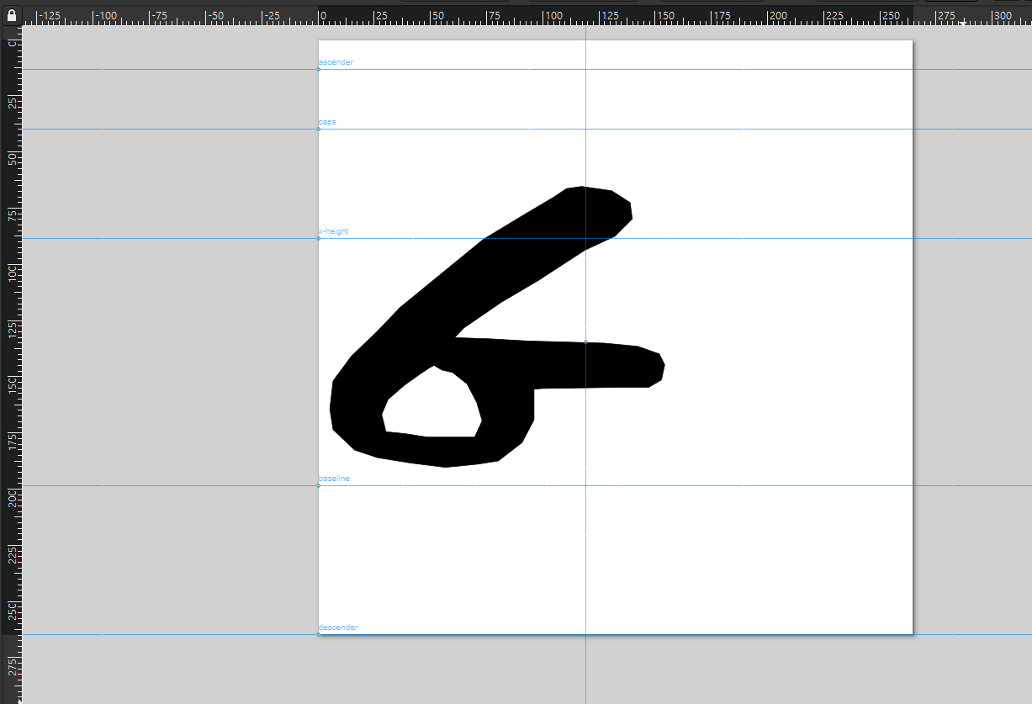
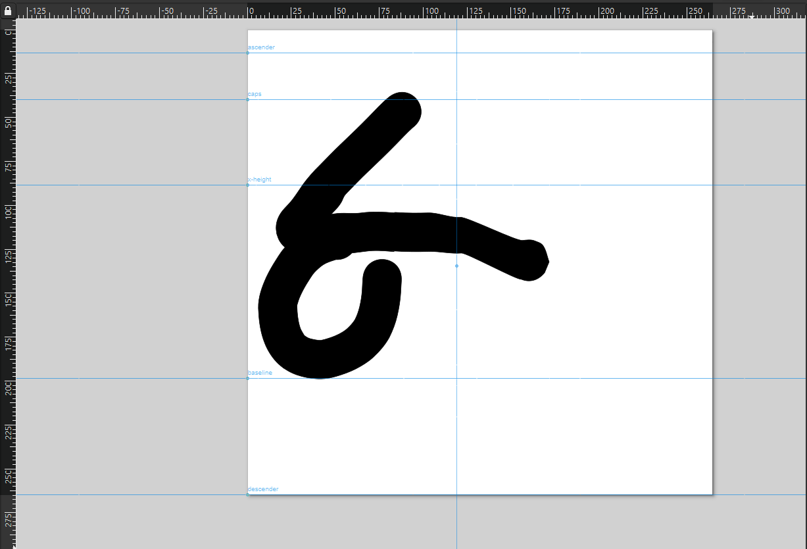
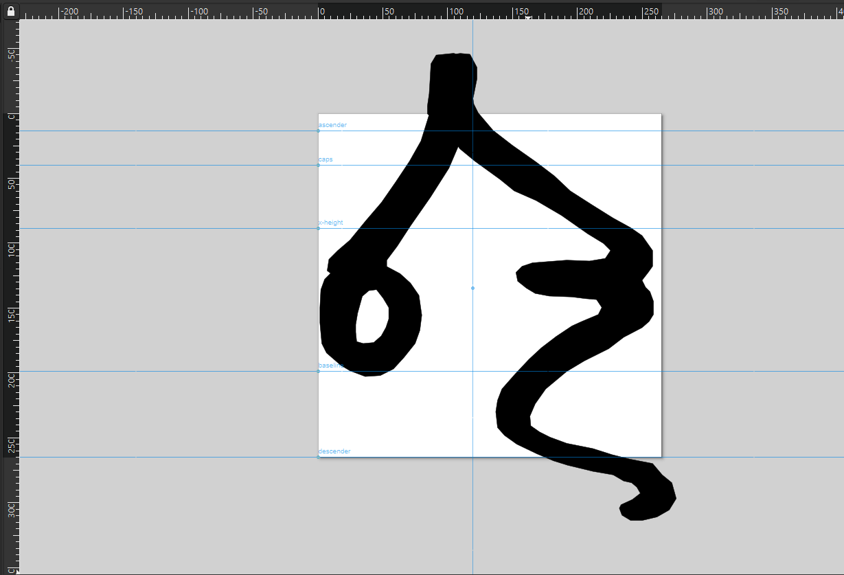
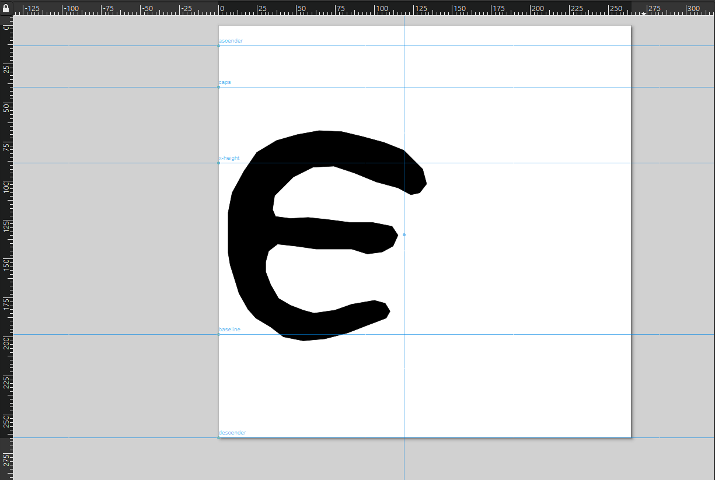
The Font (cont.)
Methodology:
Inkscape
Tracing of characters and assignment to Greek Unicode letters (lower-case and upper-case)
PUA for:
Variant forms of characters (3)
Ligatures (14)
Connector Characters (8)

Slide 7
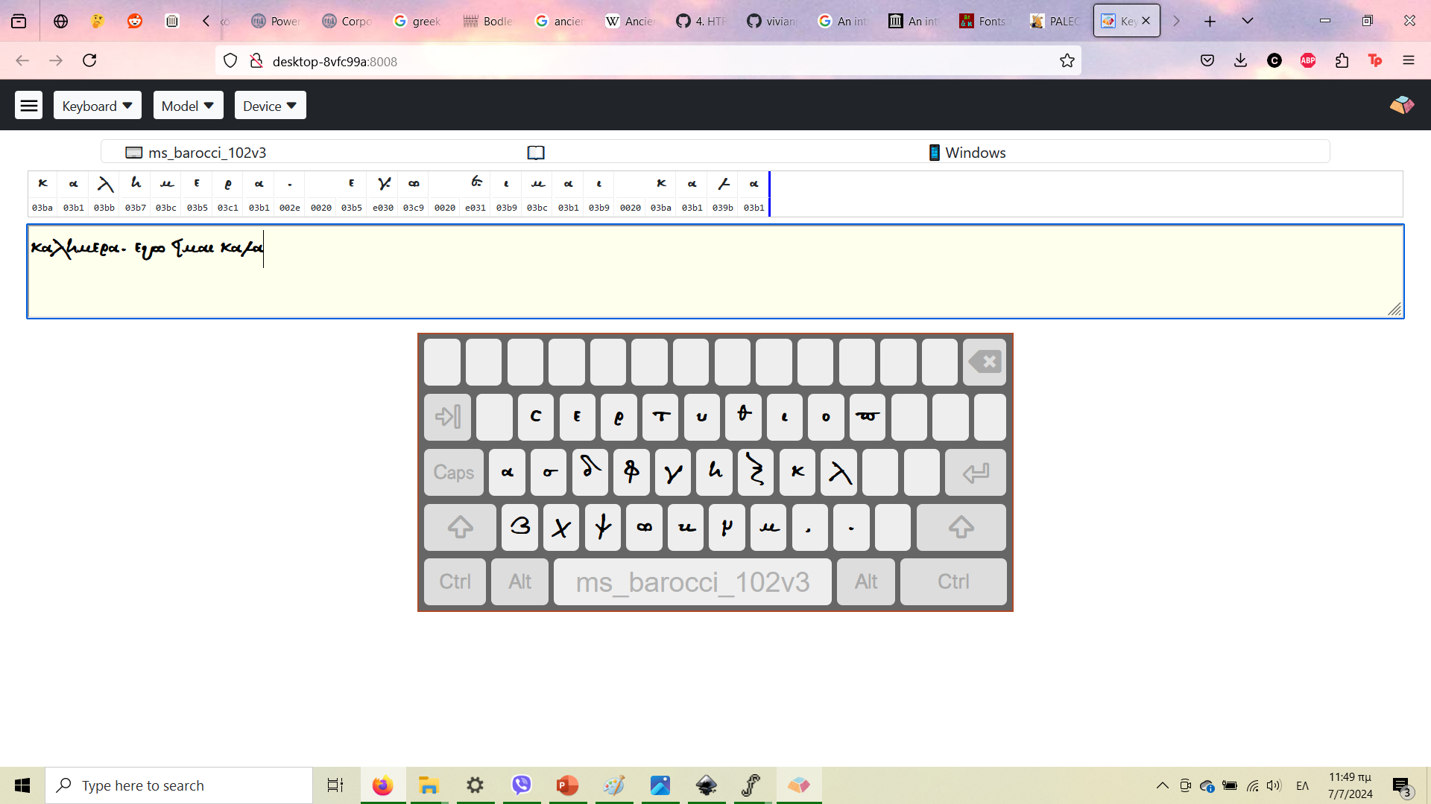
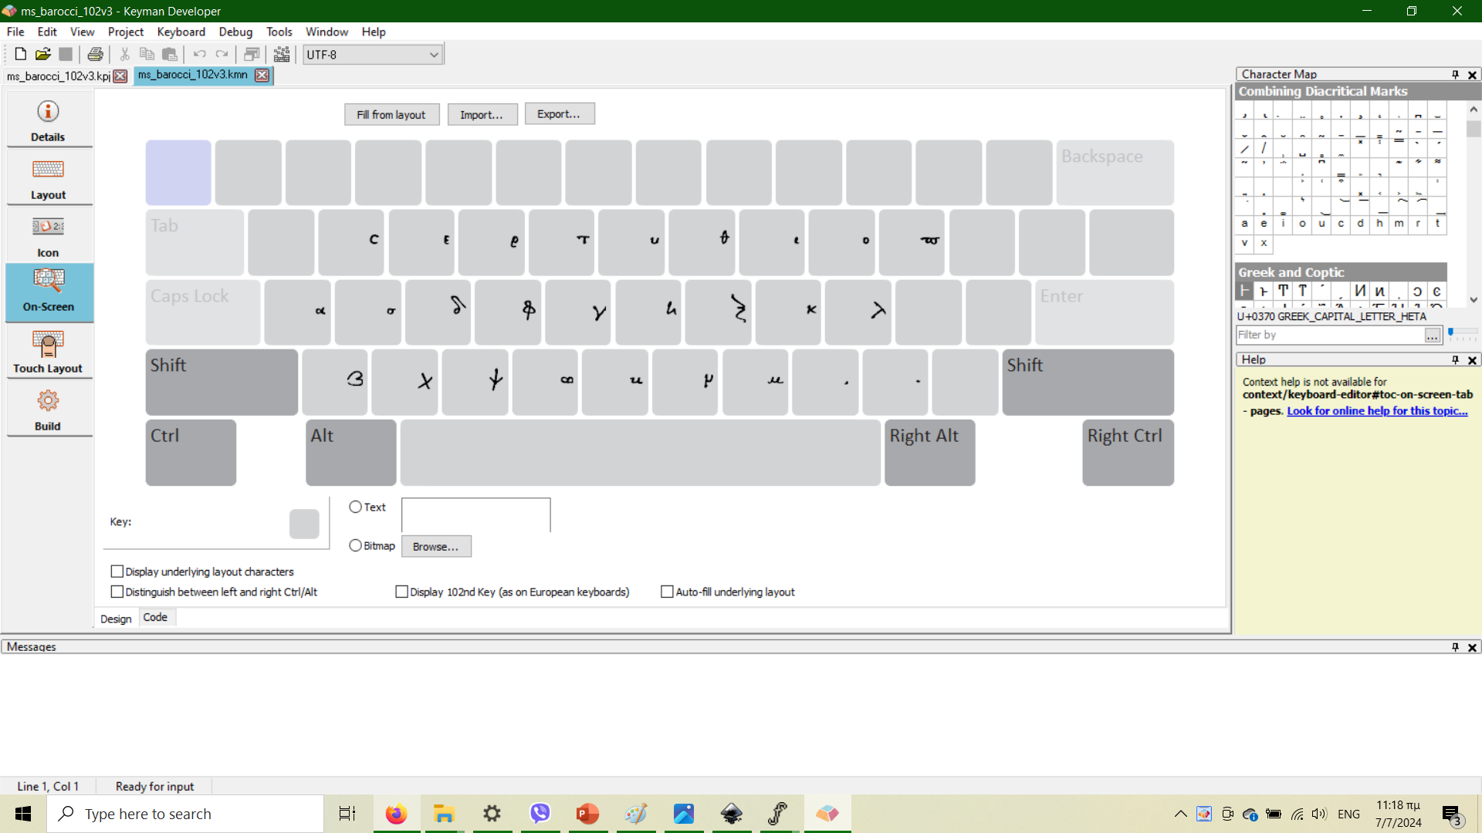
The Keyboard
FontForge
Fixing of nodes
Fixing of positioning (baseline, height, spacing)
Keyman Developer
Development of physical and on-screen keyboard

Slide 8
Purpose
Diplomatic transcription of manuscripts
Dating and contextualization
Use in DL Networks for de-coding manuscripts
Teaching and education
Public outreach and entertainment
Cavafy script by the Onassis Foundation

Slide 9
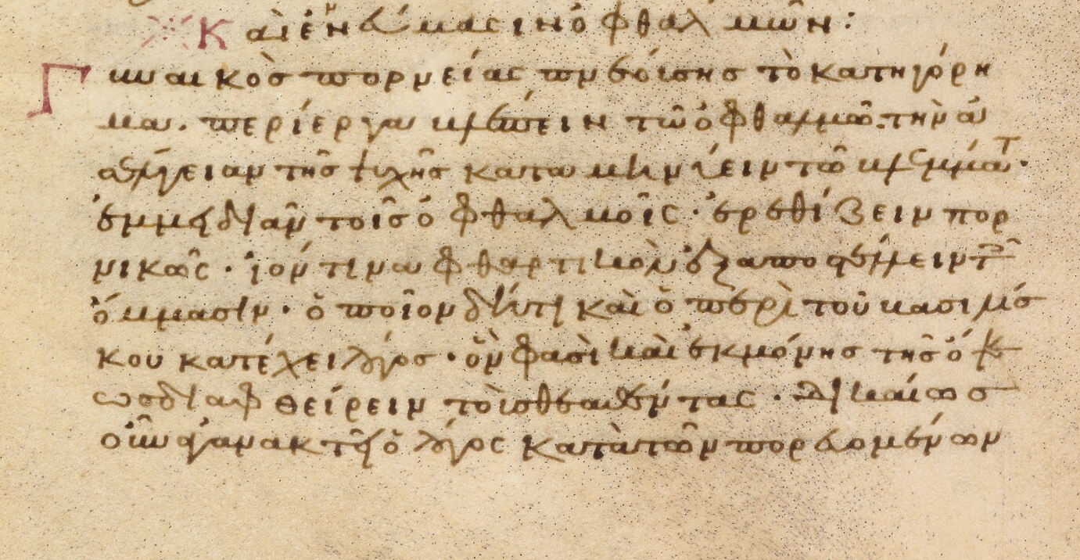
Refinement
Additions:
More variants (if applicable)
More ligatures (if applicable)
Accent marks and diacritics
Special characters
Rethinking variant forms and ligatures
Following example of Athena Ruby?
Implementation of different color schemes

Slide 10
GitHub Repository
https://github.com/ShiiraFT/GreekMinusculeFont
Work in progress. Will be appended.

